Slide 1



2019
Profit Model
Toward 50% Gross Margin

Slide 2
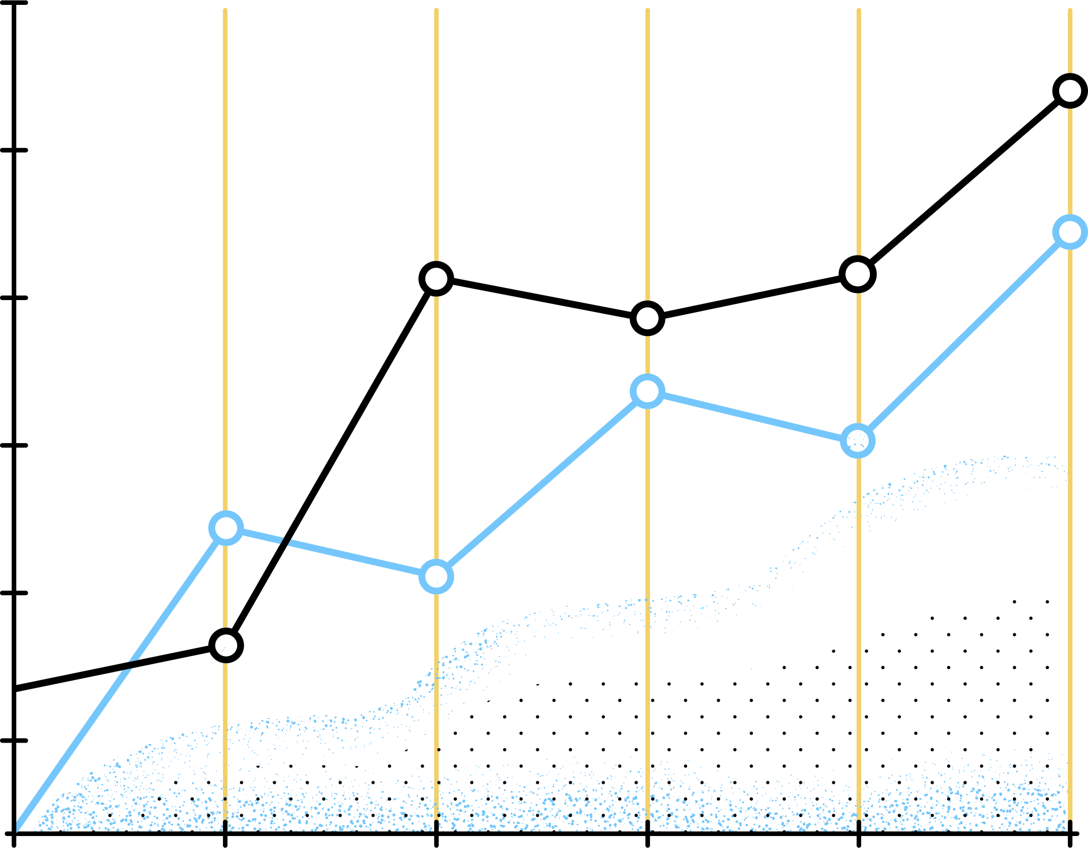


Purpose
This model aims to turn Lariat company into a more efficient business for the next year with a Gross Margin level of 50% (around 8% higher than the previous year).
Goal
Establish various strategies to turn the company into a more efficient business by analyzing revenue and cost performance.
LARIAT-RENT-A-CAR

Slide 3
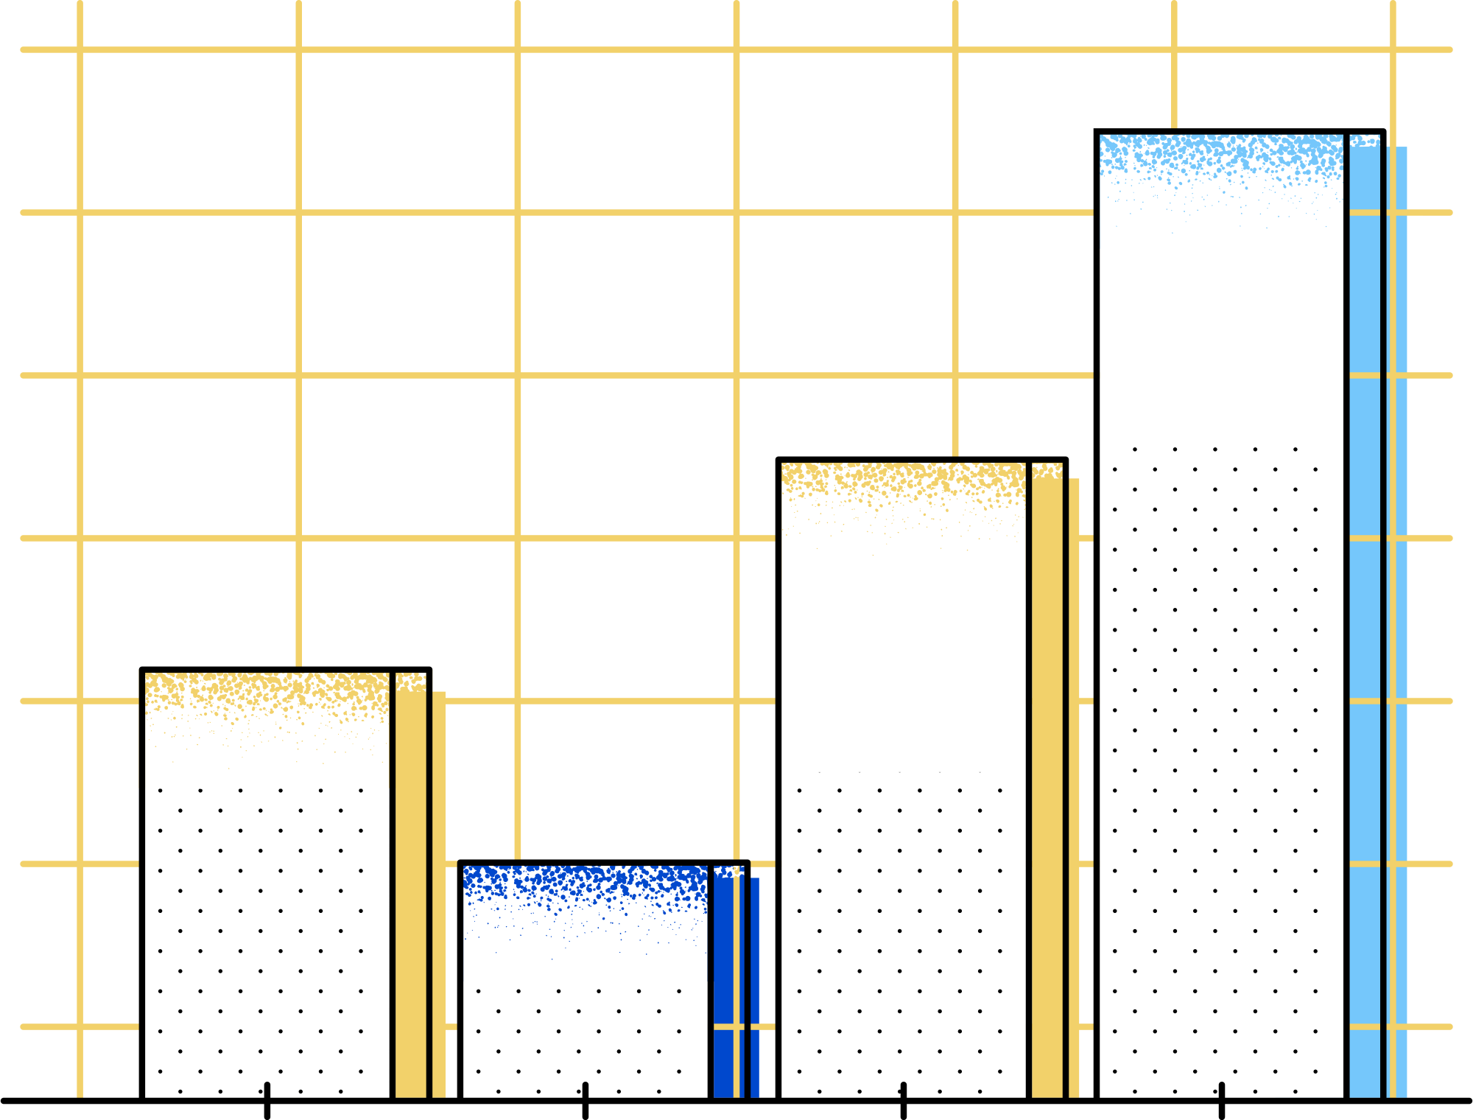
Baseline
Variables
Total Bookings | 81,318
Total Rented Days | 325,608
Average Rented Days | 4
Number of Locations | 46
Total Fleet | 4,000
Gross Revenue | $ 52,830,207
Total Annual Cost | $ 30,320,298
Net Revenue | $ 22,509,909
Gross Margin Level | 43%
LARIAT-RENT-A-CAR

Slide 4
Top 10 Vehicles by Gross Margin & Booking
1. Aston Martin DB9 2016
2. Isuzu Ascender 2017
3. Infiniti FX 2017
1. Honda Civic 2016
2. Ford Ranger 2017
3. Potiac Grand Prix 2016
LARIAT RENT-A-CAR

Slide 5
Bottom 10 Vehicles by Gross Margin & Booking
1. Daewoo Nubira 2018
2. Oldsmobile Tornado 2017
3. Audi 500CS 2017
1. Daewoo Nubira 2018
2. Dodge Sprinter 2018
3. GeoStorm 2018
LARIAT RENT-A-CAR

Slide 6
Revenue and Booking by Location
15% of the market makes 4% avg of revenue, the rest of them 2% per location.
LARIAT RENT-A-CAR

Slide 7
Strategy 1
Get rid of negative gross margin cars (20).
Replace them with the highest g. margin cars (27).
Assume a 15% of booking growth by allocating new and old cars to Fort Worth, D.C., Charlotte, Denver.
Car cost increases by 5%.
Gross Margin Level: 48%
Profit growth: 30%
LARIAT RENT-A-CAR

Slide 8
Strategy 2
Grow the fleet by 15% without eliminating inefficiencies.
Assume same avg car revenue.
Car cost increases by 5%.
Gross Margin Level: 40%
Profit growth: 8%
LARIAT RENT-A-CAR

Slide 9
Strategy 3
Grow the fleet by 15%.
Replace the negative gross margin cars.
Assume a 15% of booking increase.
Car cost increases by 5%.
Gross Margin Level: 50%
Profit growth: 56%
LARIAT RENT-A-CAR

Slide 10


Takeaways
All strategies have a profit growth, but strategy 3 reaches the 50% gross margin mark by:
Increasing booking and fleet size by 15%.
Allocating new fleet to Forth Worth, DC and Denver.
Replacing 20 poor performing cars.
Recommendation: considering an avg of 5 rented days. 56% gross margin. Marketing campaign “weekend special” is suggested.
LARIAT RENT-A-CAR

